Slide 1
Computer Vision:
Screen time of an object in a video

Slide 2

Problem Statement
Develop Deep Learning (DL) based solution which processes videos, identify objects of business interest and calculate its screen time.
Notes:
SIL level 3

Slide 3

Benefits
Low cost solution that can be deployed on smartphones to calculate screen time of a person
Children spend more time on watching TV, this solution would help parents to monitor children screen time.
Would be helpful for marketing department to deal with relevant stakeholders
Would help different business functionals make critical decisions like for ex: cost of an advertisement or impact analysis.

Slide 4
Technology stack
Approach
Extraction of frames from video
Split data into train and validation dataset
Data has 3 classes to learn
Computer vision model tested on a new video.
Convolutional Neural Network (CNN)
Used VGG16 model architecture to train model on our specific dataset
Used Confusion matrix as accuracy matrices.
Machine learning libraries:
Tensorflow
Keras
TensorflowJS
Scikit-Learn
Python 3.6
GPU - GP107 [GeForce GTX 1050 Ti]

Slide 5
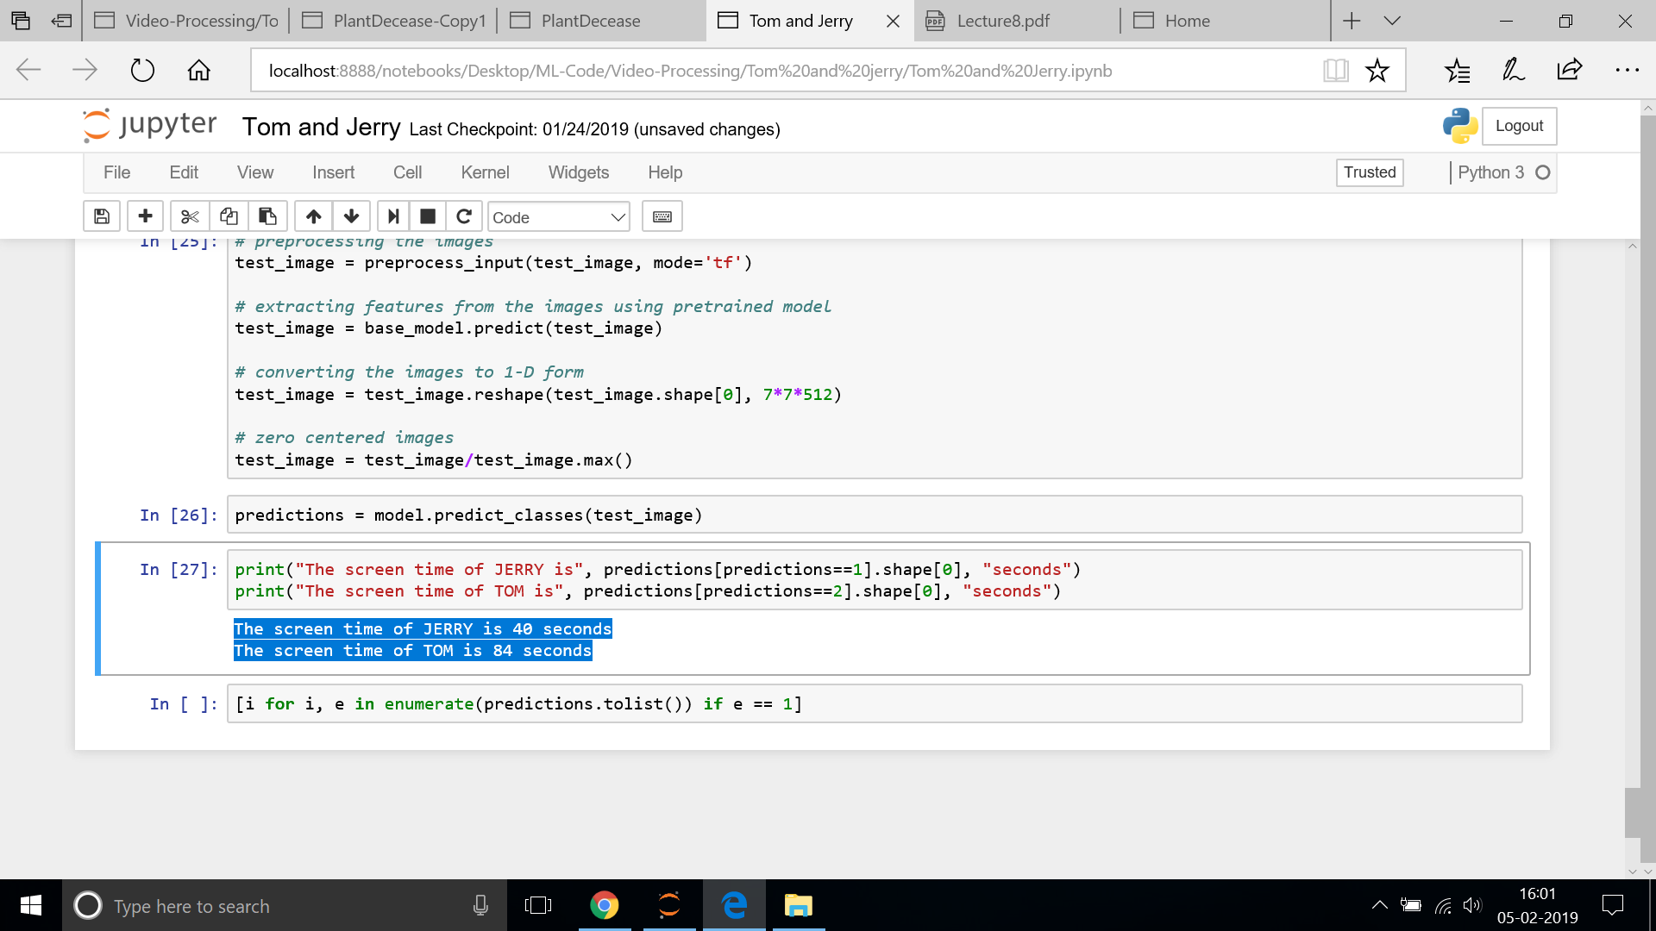
Sample Code

Slide 6
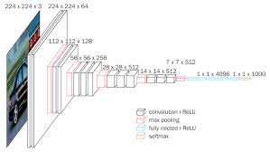
VGG 16 Architecture

Slide 7
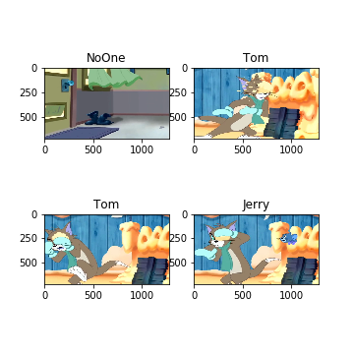
Results
VGG16 model produced 89% accuracy on identifying the person precisely on new video.
Character | Screen Time
Jerry | 40 Seconds
Tom | 84 Seconds

